Slide 1

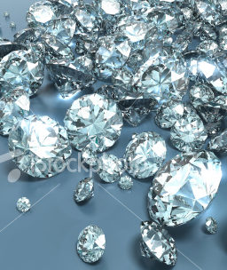
Omega Diamonds case in Belgium: an opportunity to repatriate assets to Angola
David Renous
European Parliament
20th June 2018
This PhotSA

Slide 2
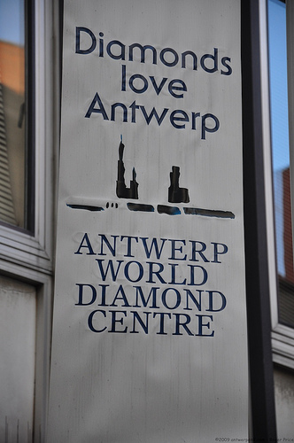
Diamonds diverted
Between 2003 and 2008, 364 lots of Angolan rough diamonds, diverted through the United Arab Emirates and Switzerland, were imported to Antwerp by Omega Diamonds.
90% of this amount belong to the Angolan State and must be repatriated using the EU
Over10 years of operation, more than $ 8 billion USD have been eluded from the Angolan State
This Photo by Unknown Author is licensed under CC BY-NC-SA

Slide 3
The mechanism-Triangular trade
ASCORP (Angola)
TULIP (Dubai) OMEGA (Antwerp)

Slide 4
How it works
Angola mining companies and informal sector obliged to sell diamonds at 40% of value
ASCORP
LUANDA, ANGOLA
(Isabel dos Santos and Omega Diamonds)
Buy undervalued diamonds
TULIP
DUBAI, UAE
False invoices
Back to back
OMEGA DIAMONDS
ANTWERP, BELGIUM
Diamonds are sold overvalued
60% of value of the diamonds is illegally appropriated and finances corruption

Slide 5
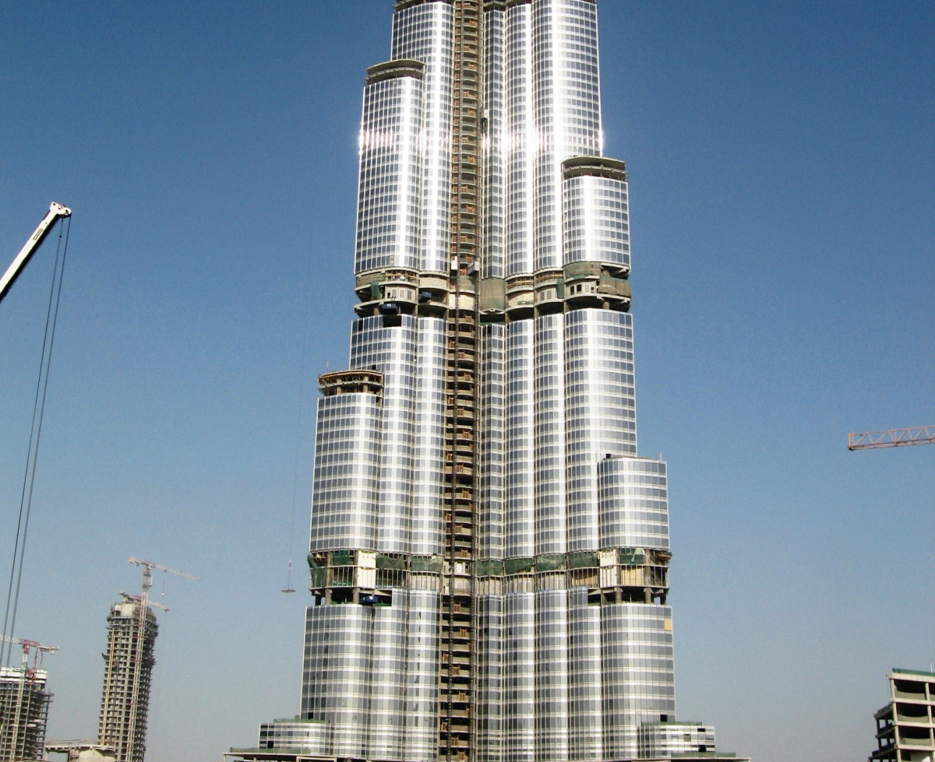
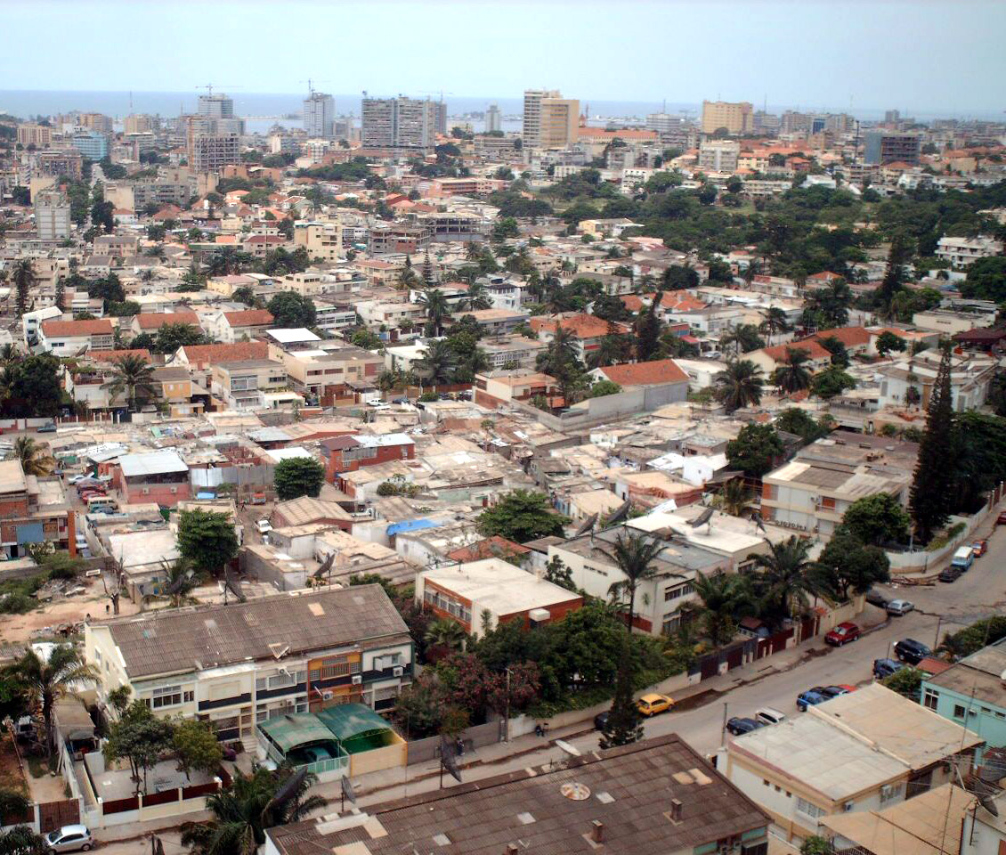
Explaining the scheme (I)
A monopoly allows the group to buy the diamonds at flat prices.
The mining companies and the informal sector traders were forced to comply with a price list dictated by Omega from Antwerp. They were obliged to sell up to 40% of the actual price for mixed parcels without counting the big stones. A discount of 60%!
Diamonds purchased by ASCORP were strongly undervalued.
The accounting simulated a fictitious sale and established a false invoice, in counterpart a CK -Certificate Kimberley was issued with mention Origin: Angola Original
The shipment was then presented to customs for export, and, therefore, exported to TULIP in Dubai HUB.

Slide 6
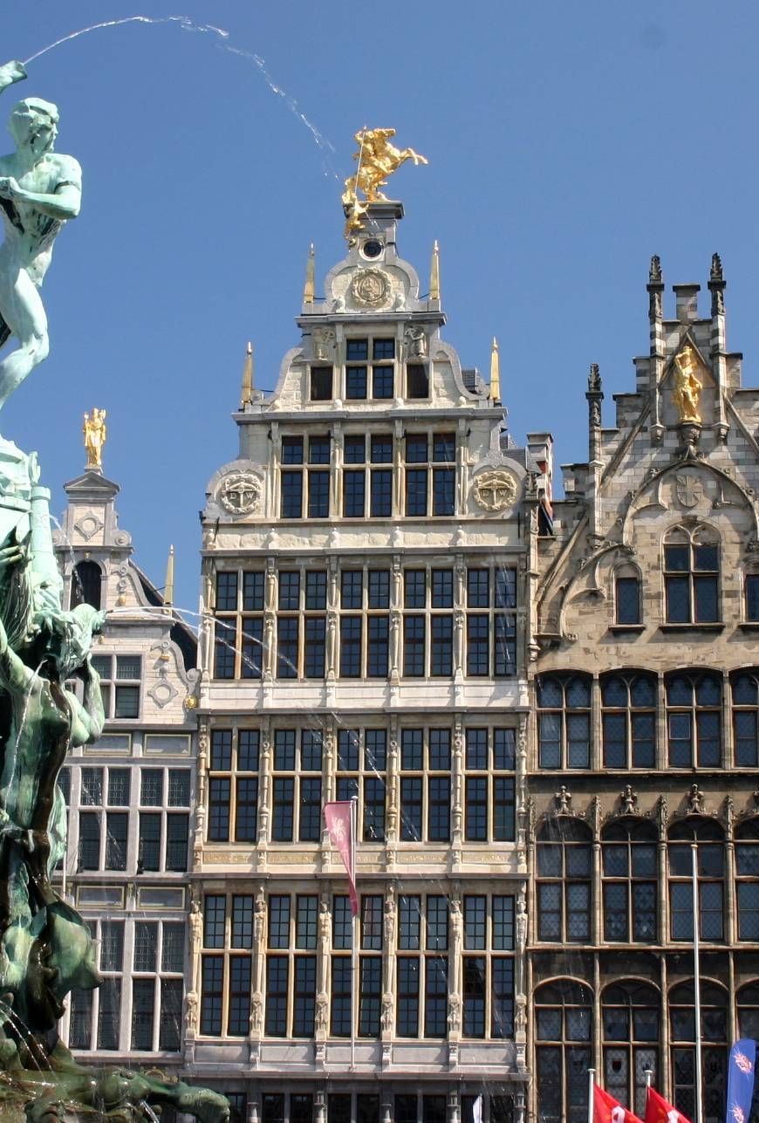
Explaining the scheme (II)
TULIP then performed a simple technique, referred in international jargon, as Back to Back ... Without even opening the envelopes and analyzing the contents of the packages, the employee of TULIP also simulated a fictitious sale to OMEGA DIAMONDS, and issued a false invoice, in exchange for which a fake Kimberley certificate was issued by Dubai (and later Geneva) with mention: Origin: Dubai (UAE-) - quality: mixed – note that neither Dubai nor Geneva are producing countries
The shipment then flew with the destination JNB INTL AIRPORT in South Africa for a stealthy transit ... the stones finally landed in Belgium, overvalued, on the sorting trays of Omega Diamonds in Antwerp
This Photo by Unknown Author is licensed under CC BY-SA

Slide 7
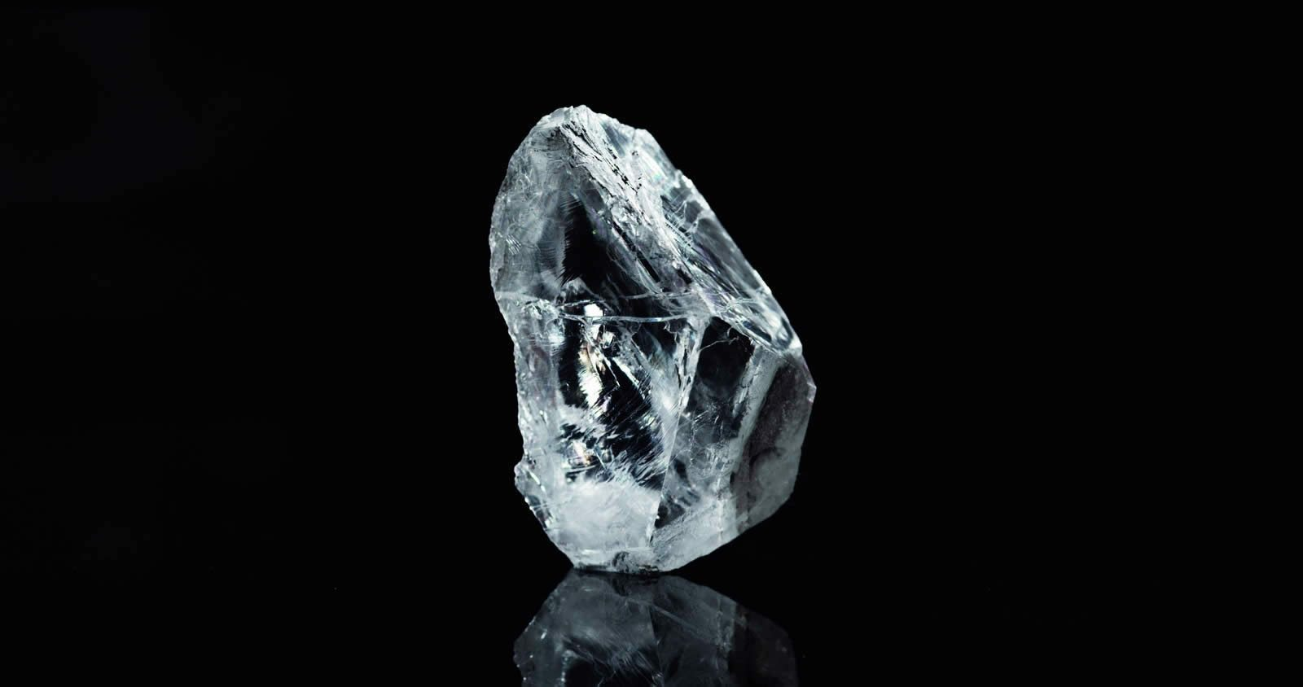

DeGrisogono link
In 2012, Isabel and her husband Sindika Dokolo bought 75% of the shares of the Swiss Jeweler De Grisogono, Fawaz Gruosi.
This brand offers the perfect opportunity to pass from the darkness to the light:
Shiny vitrine …Boutique in London - N-Y; Miami; L.A – clients: The Jet Set and Hollywood Stars
February 2016: Australian mining company Lucapa Diamond Company extracts from its Lulo site a 404 ct pure D-pure diamond; the stone is sold for $ 16 million via SODIAM to Nemesis International, a Dubai-based screen company owned by Sindika Dokolo and directly related to De Grisogono. Fawaz Gruosi has cut the emerald-cut gemstone of 163ct; the cut stone set in a flamboyant pendant was sold by Christie's for $ 33.7 million, the buyer remained "anonymous".
December 2017: The Angolan national company SODIAM announces its decision to leave the partnership with Victoria Holding Limited of the group of jewelers De Grisogono.
10 April 2018: Reuters- De Grisogono ”will cut jobs because of weak sales".
28 June 2018: 28 job cuts occur in Europe.

Slide 8

Conclusions
Time to repatriate capital to Angola using Europe Confiscation & Asset Recovery Schemes
Time to give Angolan people the fruition of its wealth
Time to do justice
This Photo by Unknown Author is licensed under CC BY-SA

